Slide 1
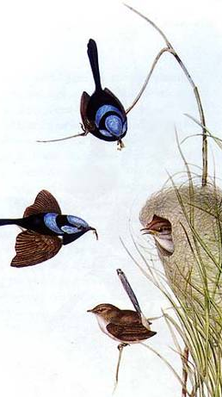
Animal Sociality Cooperation
Do animals cooperate?
How? Why?

Slide 2
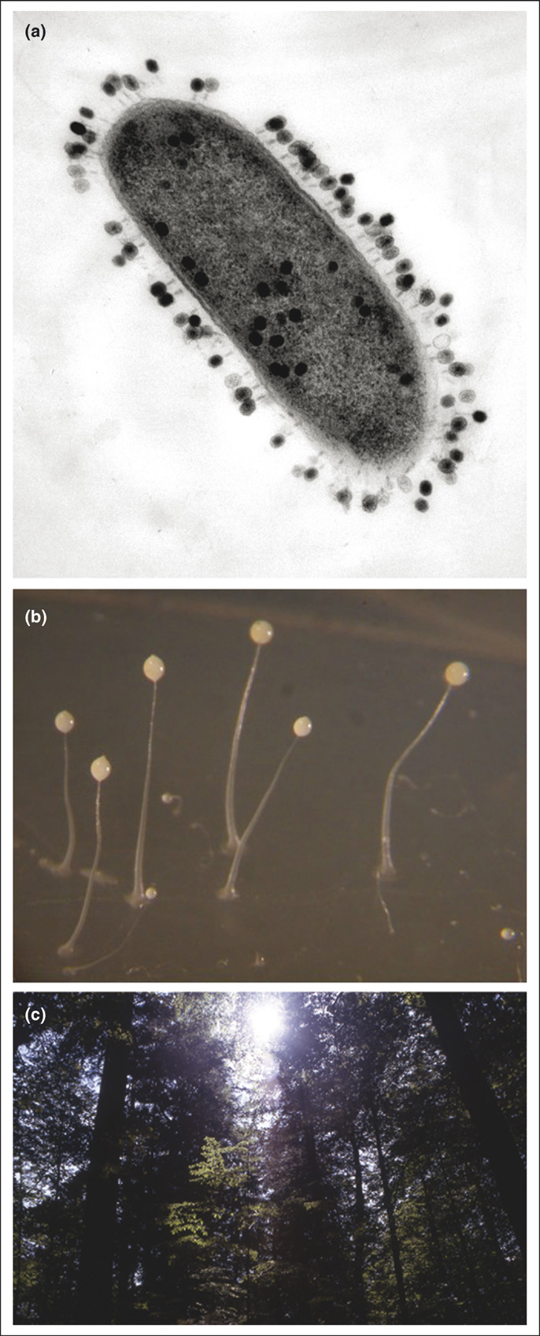
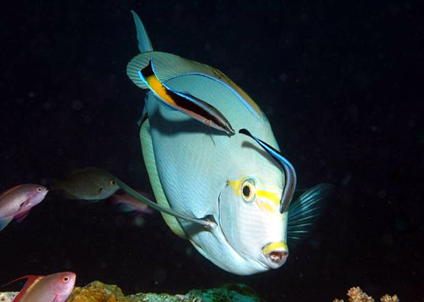
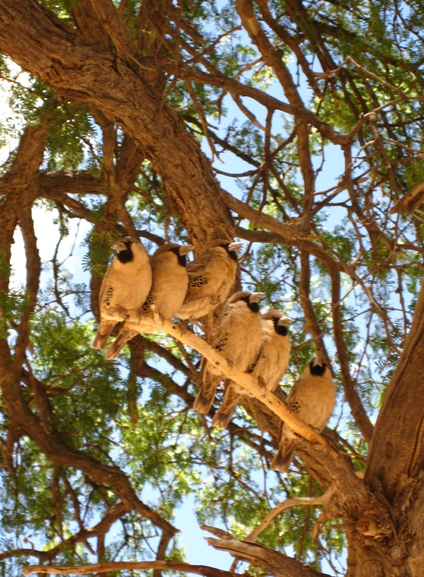
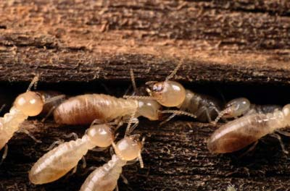
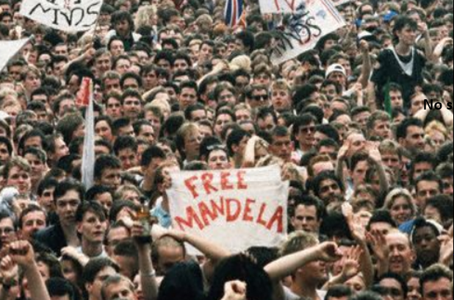
Introduction
Cooperation is widespread: from microbes to humans
© Marta Soares

Slide 3
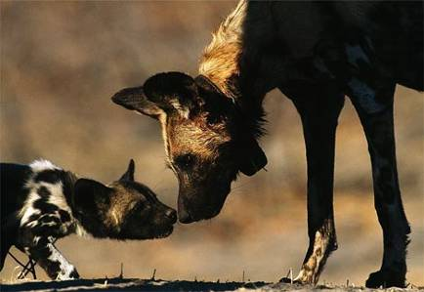
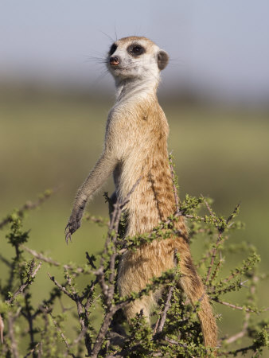
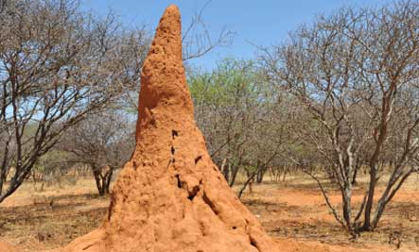
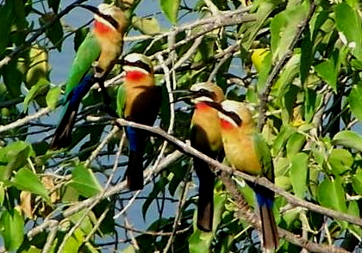
And is diverse in purpose
© Marta Soares

Slide 4
Cooperation
Mutualism – Both individuals benefit and how much they invest in cooperation is similar
Cooperation/Altruism –Both individuals benefit, but one invests more than the other, (only one individual benefits).
+
+
=
+
+
-
+
=
+
+

Slide 5

But coperation has a cost.
Costs and benefits are defined on
the basis of the lifetime fitness
(i.e. the number of descendants
produced at the end of an
individual’s life)
Examples of mechanisms through
which fitness is affected are:
- Failing to reproduce
- Increased risk-taking
- Decreased share of resources
such as food
- Decreased body condition
- Etc

Slide 6
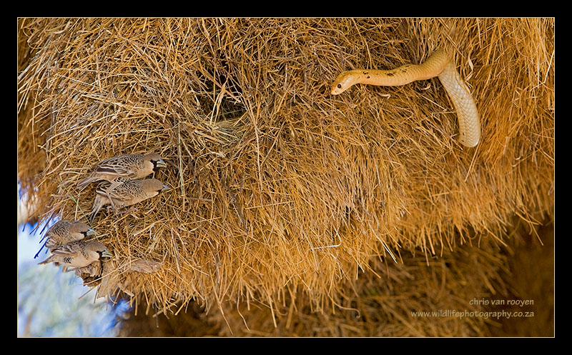
When individuals cooperate, the benefits of the work are shared while the costs are suffered by each individual,
So cooperative behaviour is vulnerable to exploitation by selfish individuals
But if there is a cost, how much
Should an individual invest in the communal task?
This leads to conflict over how much each individual should
Invest in cooperating

Slide 7
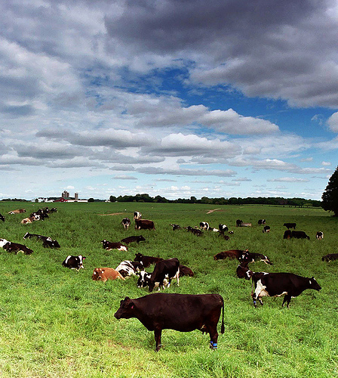
This social dilemma is known as the “Tragedy of the commons”
Imagine a communal pasture, shared fish stocks or the global climate!
When individuals have to manage a shared resource, and act in their own interest at the expense of the communal good, this can result in overconsumption, underinvestment, pollution or depletion of resources.

Slide 8
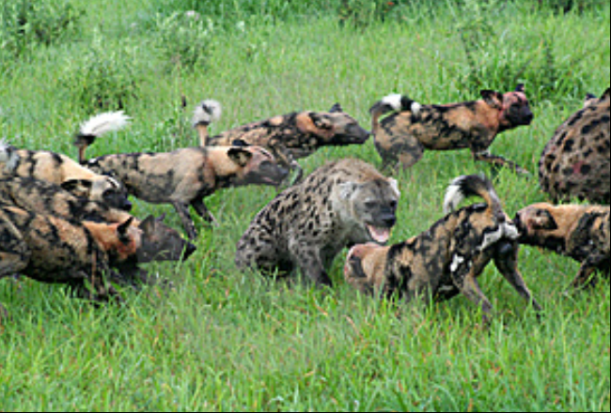
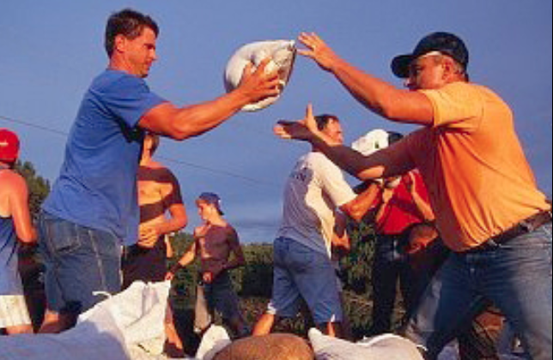
How is the stability of cooperation maintained?
‘Altruistic genes’ do not leave descendants and hence are not favoured by natural selection
For cooperation to evolve and be
maintained, the benefits of cooperating need to be higher than the costs

Slide 9
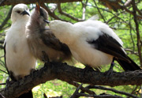
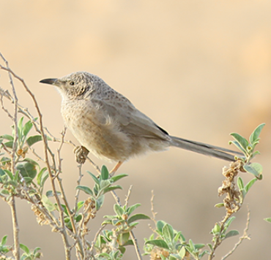
How can the 'tragedy of the commons' be avoided
and cooperation maintained?
Two classes of explanations for cooperation:
i) it provides an indirect benefit by
helping close kin that share genes with the individual that helps (e.g. helping to raise siblings or nephews)
ii) it may provide a direct benefit to the individual that performs the behaviour, which outweighs the cost of performing the behaviour (e.g. sentinel behaviour)

Slide 10
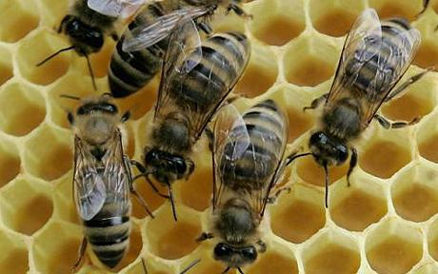
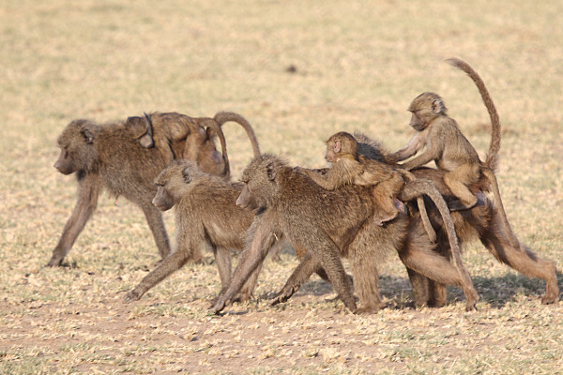

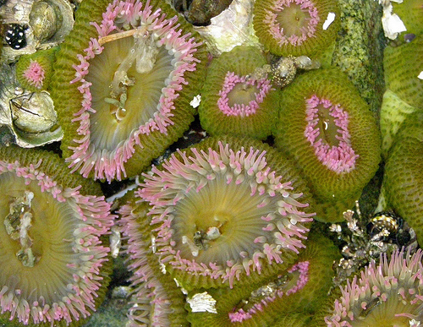
Most cooperative organisms live
and interact with kin
i) Kin selection

Slide 11
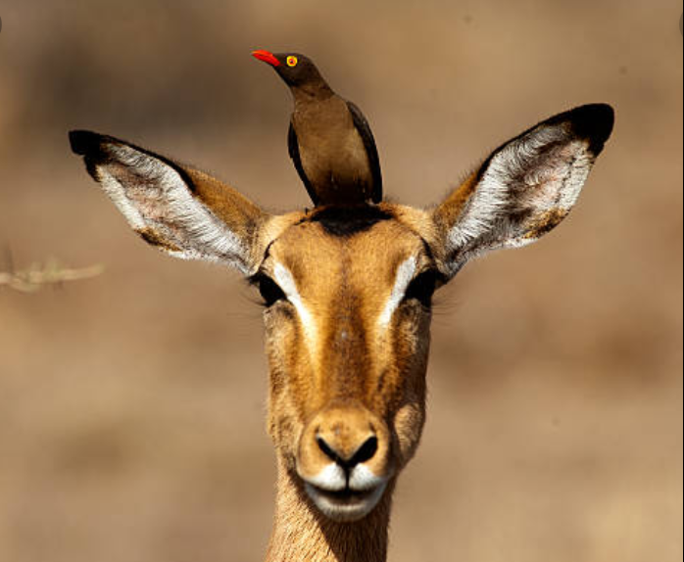
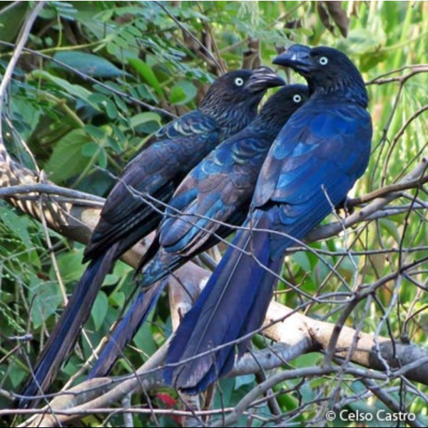
But others don´t!

Slide 12
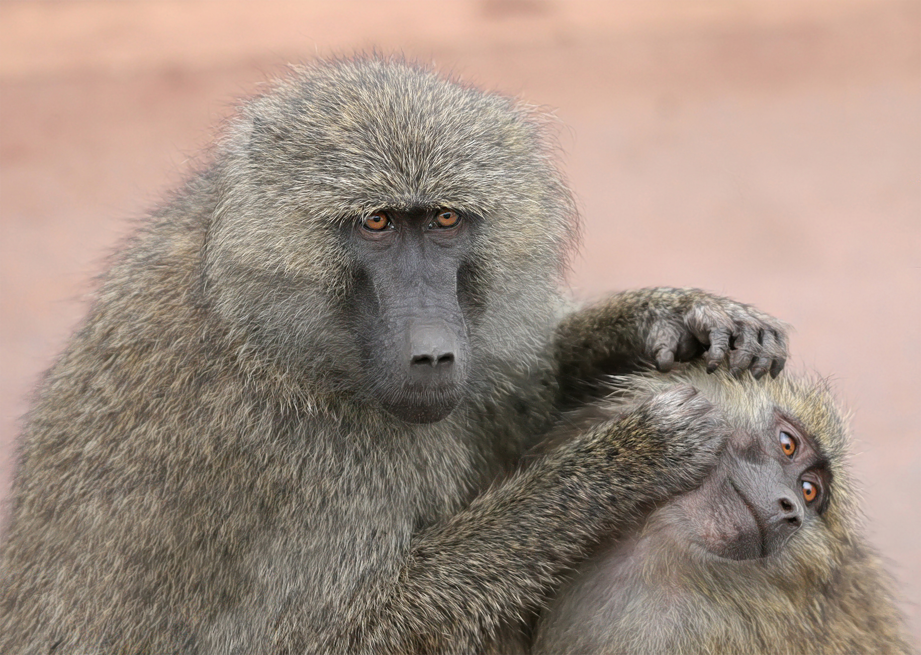
ii) Direct benefits
a) Reciprocity
When there are multiple encounters between the same partners, “If I cooperate now, you may cooperate later”
A good example is allogrooming in mammals

Slide 13
ii) Direct benefits
b) Indirect or Generalised Reciprocity &
Partner Choice
Helping others establishes a reputation
and more cooperative individuals
can be preferred as social or sexual
partners
For example, in cleaner fish,
individuals that honestly clean their ‘clients’ parasites are preferred to
those that cheat and instead eat
the clients’ mucous tissue

Slide 14



Thank you!
Credits: This presentation was done by
Sónia Cardoso based on a model
created by Slidesgo and a lecture by
Rita Covas and Includes Flaticon icons
and Freepik Images and infographics.
Do you have any question?
rita.covas@cibio.up.pt

